Slide 1




University Institute of Engineering
Department of Computer Science & Engineering
COMPUTER ORGANIZATION & ARCHITECTURE
(23CST-204/23ITT-204)
ER. SHIKHA ATWAL
E11186
ASSISTANT PROFESSOR
BE-CSE

Slide 2
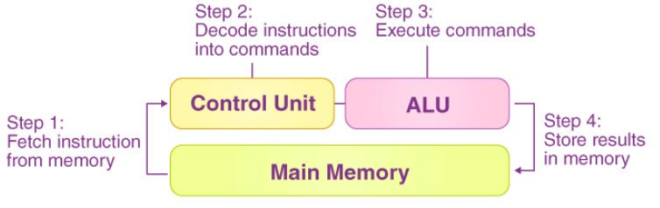
CPU
The Central Processing Unit (CPU) is the primary component of a computer responsible for interpreting and executing instructions. It is often referred to as the "brain" of the computer. In computer organization and architecture, the CPU can be broken down into various subcomponents, each with specific responsibilities.
Components of the CPU
1. Control Unit
The CPU control unit is a component of the computer’s CPU (central processing unit) that directs the processor’s operation. John von Neumann included it in his Von Neumann Architecture. The control unit’s job is to instruct the computer’s arithmetic/logic unit, memory, and input and output devices on how to respond to the instructions supplied to the processor.

Slide 3
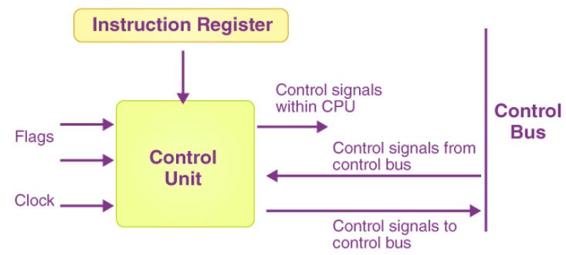
The control unit fetches internal program instructions from the main memory to the processor instruction register, and it generates a control signal based on the contents of this register to supervise the execution of these instructions.
Working of Control Unit
A control unit receives data from the user and translates it into control signals that are subsequently delivered to the central processor. The processor of the computer then instructs the associated hardware on what operations to do. Because CPU architecture differs from manufacturer to manufacturer, the functions performed by a control unit in a computer are dependent on the CPU type. The following are some examples of devices requiring a control unit:
CPUs or Central Processing Units
GPUs or Graphics Processing Units
Block diagram of Control Unit

Slide 4
Functions of Control Unit
It coordinates the flow of data out of, into, and between the various subunits of a processor.
It understands commands and instructions.
It regulates the flow of data within the processor.
It accepts external commands or instructions, which it turns into a series of control signals.
It is in charge of a CPU’s multiple execution units (such as ALUs, data buffers, and registers).
It also performs a variety of activities, including fetching, decoding, handling execution, and storing results.
Types of Control Unit
The design of the control unit depends on the type of control unit in use. Here are the types of control units:
Hardwired Control Unit
The control signals that are necessary for instruction execution control in the Hardwired Control Unit are generated by specially built hardware logical circuits, and we can’t change the signal production mechanism without physically changing the circuit structure.

Slide 5
Microprogrammed Control Unit
The existence of the control store, which is used to store words containing encoded control signals required for instruction execution, is the main distinction between the unit structure and the hardwired control unit structure.
We will discuss these two in detail with their structures in later chapters.
Arithmetic Logic Unit
ALU conducts arithmetic and logic operations. It is a major component of the CPU in a computer system.
It can execute all arithmetic and logic operations, including Boolean comparisons, such as subtraction, addition, and shifting (XOR, OR, AND, and NOT operations). Binary numbers can also perform bitwise and mathematical operations. AU (arithmetic unit) and LU (logic unit) are two types of arithmetic logic units. The ALU’s operands and code instruct it on which operations to perform based on the incoming data. When the ALU has finished processing the data, it sends the result to the computer memory.

Slide 6
Operations performed by ALU
The design and function of the ALU may vary amongst processors. Some ALUs, for example, are designed solely to conduct integer calculations, whereas others are built to perform floating-point computations. Some processors have a single arithmetic logic unit that performs operations, whereas others have many ALUs that conduct calculations. ALU’s operations are as follows:
Arithmetic Operations
Add: A and B are summed and the sum appears at Y and carry-out.
Add with carry: A, B and carry-in are summed and the sum appears at Y and carry-out.
Subtract: B is subtracted from A (or vice-versa) and the difference appears at Y and carry-out. For this function, carry-out is effectively a "borrow" indicator. This operation may also be used to compare the magnitudes of A and B; in such cases the Y output may be ignored by the processor, which is only interested in the status bits (particularly zero and negative) that result from the operation.
Subtract with borrow: B is subtracted from A (or vice-versa) with borrow (carry-in) and the difference appears at Y and carry-out (borrow out).
Two's complement (negate): A (or B) is subtracted from zero and the difference appears at Y.
Increment: A (or B) is increased by one and the resulting value appears at Y.
Decrement: A (or B) is decreased by one and the resulting value appears at Y.

Slide 7
Bitwise Logical Operations
AND: The bitwise AND
OR: The bitwise OR
NOT: The bitwise NOT
Exclusive-OR: The bitwise XOR
One's complement: All bits are inverted i.e., 0 to 1 and 1 to 0.

Slide 8
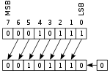
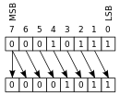
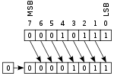
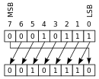
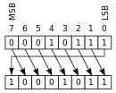
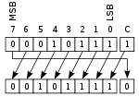
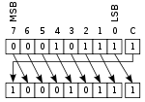
Bit Shift Operations
Bit shift examples for an eight-bit ALU
Type | Left shift | Right shift
Arithmetic
Logical
Rotate
Rotate through carry

Slide 9
Arithmetic shift: the operand is treated as a two's complement integer, meaning that the most significant bit is a "sign" bit and is preserved.
Logical shift: a logic zero is shifted into the operand. This is used to shift unsigned integers.
Rotate: the operand is treated as a circular buffer of bits so its least and most significant bits are effectively adjacent.
Rotate through carry: the carry bit and operand are collectively treated as a circular buffer of bits.
Although an ALU can be designed to perform complex functions, the resulting higher circuit complexity, cost, power consumption and larger size makes this impractical in many cases.

Slide 10
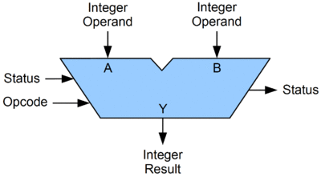
ALU Signals
The ALU contains a variety of electrical input and output connections, which result in the digital signals being cast between the ALU and the external electronics. External circuits send signals to the ALU input, and the ALU sends signals to the external electronics.
Basic ALU Design

Slide 11
Opcode
The opcode input is a parallel bus that conveys to the ALU an operation selection code, which is an enumerated value that specifies the desired arithmetic or logic operation to be performed by the ALU. The opcode size (its bus width) is related to the number of different operations the ALU can perform; for example, a four-bit opcode can specify up to sixteen different ALU operations. Generally, an ALU opcode is not the same as a machine language opcode, though in some cases it may be directly encoded as a bit field within a machine language opcode.
Data
A basic ALU has three parallel data buses consisting of two input operands (A and B) and a result output (Y). Each data bus is a group of signals that conveys one binary integer number. Typically, the A, B and Y bus widths (the number of signals comprising each bus) are identical and match the native word size of the encapsulating CPU (or other processor).
Status
The status outputs are various individual signals that convey supplemental
information about the result of an ALU operation. These outputs are usually stored in registers so they can be used in future ALU operations or for controlling conditional branching. The collection of bit registers that store the
status outputs are often treated as a single, multi-bit register, which is referred to as the "status register" or "condition code register".

Slide 12
General-purpose ALUs commonly have status signals such as:
Carry-out, which conveys the carry resulting from an addition operation, the borrow resulting from a subtraction operation, or the overflow bit resulting from a binary shift operation.
Zero, which indicates all bits of the Y bus are logic zero.
Negative, which indicates the result of an arithmetic operation is negative.
Overflow which indicates the result of an arithmetic operation has exceeded the numeric range of the Y bus.
Parity which indicates whether an even or odd number of bits on the Y bus are logic one. The status input allows additional information to be made available to the ALU when performing an operation. Typically, this is a "carry-in" bit that is the stored carry-out from a previous ALU operation.

Slide 13
ALU Circuit Operation
An ALU is a combinational logic circuit, meaning that its outputs will change asynchronously in response to input changes.
In normal operation, stable signals are applied to all of the ALU inputs and, when enough time (known as the "propagation delay") has passed for the signals to propagate through the ALU circuitry, the result of the ALU operation appears at the ALU outputs.
The external circuitry connected to the ALU is responsible for
o ensuring the stability of ALU input signals throughout the operation, and
o for allowing sufficient time for the signals to propagate through the ALU before sampling the ALU result.
In general, external circuitry controls an ALU by applying signals to its inputs.
For example, a CPU begins an ALU addition operation by routing operands from their sources (which are usually registers) to the ALU's operand inputs, while the control unit simultaneously applies a value to the ALU's opcode input, configuring it to perform addition. At the same time, the CPU also routes the ALU result output to a destination register that will receive the sum. The ALU's input signals, which are held stable until the next clock, are allowed to propagate through the ALU and to the destination register while the CPU waits for the next clock. When the next clock arrives, the destination register stores the ALU result and, since the ALU operation has completed, the ALU inputs may be set up for the next ALU operation.

Slide 14
Registers
Registers are used in computer systems as places to store a wide variety of data, such as addresses, program counters, and data necessary for program execution. Put simply, a register is a hardware device that stores binary data. Registers are located on the processor so information can be accessed very quickly.
D flip-flops can be used to implement registers. One D flip-flop is equivalent to a 1-bit register, so a collection of D flip-flops is necessary to store multi-bit values.
For example, to build a 16-bit register, we need to connect 16 D flip-flops together. These collections of flip-flops must be clocked to work in unison. At each pulse of the clock, input enters the register and cannot be changed (and thus is stored) until the clock pulses again.
Information is written to registers, read from registers, and transferred from register to register.
Registers are not addressed in the same way that memory is addressed (recall that each memory word has a unique binary address beginning with location 0).
Registers are addressed and manipulated by the control unit itself.

Slide 15
CPU Registers and their Functions
Registers in CPU are of different types that each do a specific job when the computer
follows instructions. Let's explore the primary types of CPU registers and their respective functions:
Data Registers: Data registers, also called general-purpose registers, hold information while the computer works on it. They are really important for doing math and logical tasks on the CPU.
Address Registers: Address registers keep track of where information is stored in memory. As well as making it easier for the computer to find and use data. They help move information between the CPU and memory smoothly.
Control Registers: Control registers in CPU helps to manage things like interruptions, how programs run, and the status of the system. They also make sure all parts of the CPU work together smoothly.
Special Purpose Registers: Some registers have specific jobs, like the Program Counter (PC). Which also remembers where the next instruction is stored in memory for the CPU to use.

Slide 16
Types of CPU Registers
CPU registers are sorted into different types based on what they do and how they are used inside the CPU. So, here are some common types of CPU registers:
Data Registers
Accumulator (ACC): Holds numbers for math and logic.
General-Purpose Registers (GPRs): Can hold different types of info during programs, like numbers or addresses.
Address Registers
Memory Address Register (MAR): Keeps track of where data or instructions are stored in memory.
Index Registers (IX and IY): Helps find specific memory locations by adding to a base address.
Control Registers
Program Counter (PC): Points to the next instruction for the CPU to use.
Instruction Register (IR): Holds the current instruction the CPU is working on.
Stack Pointer (SP): Manages the stack, like when functions call each other.

Slide 17
Types of CPU Registers
4. Status Registers
Flags Register in CPU: This shows if math or logic operations have certain outcomes, like if a number is zero or if there's been an overflow.
5. Floating-Point Registers
They are specialized hardware components within a computer's central processing unit (CPU) designed to efficiently handle floating-point arithmetic operations. Floating-point numbers are used to represent real numbers, including both rational numbers (fractions) and irrational numbers (such as the square root of 2 or pi), with a fractional part and an exponent.

Slide 18
Purpose of Registers in CPU
Registers in computing serve several crucial purposes:
Fast Data Access: Registers are the quickest memory in a computer since they're right inside the CPU. This means getting data from them is almost instant, unlike getting it from RAM.
Instruction Execution: Registers hold onto data that the CPU is working with, like numbers for math or memory addresses for moving data around.
Control and Status: Registers keep track of how the CPU and the whole computer system are running. For example, the program counter remembers where the next instruction is, and flags signal things like if a math operation had a big number or
if the result is zero.
Data Storage: Registers keep important data temporarily, like stuff taken from RAM or devices, or numbers being used in calculations.
Addressing: Some registers help the CPU find specific spots in memory to read from or write to.
Registers are essential for the efficient operation of a CPU, enabling it to execute instructions, perform calculations, and manage data effectively.

Slide 19
Cache Memory
A small, high-speed memory located within or near the CPU.
Stores frequently used instructions and data to reduce access time.
Buses
Data Bus: Transfers data between the CPU, memory, and I/O devices.
Address Bus: Transfers memory addresses the CPU needs to access.
Control Bus: Sends control signals (e.g., read/write) to coordinate operations.

Slide 20
References
Reference Books:
J.P. Hayes, “Computer Architecture and Organization”, Third Edition.
Mano, M., “Computer System Architecture”, Third Edition, Prentice Hall.
Stallings, W., “Computer Organization and Architecture”, Eighth Edition, Pearson Education.
Text Books:
Carpinelli J.D,” Computer systems organization &Architecture”, Fourth Edition, Addison Wesley.
Patterson and Hennessy, “Computer Architecture” , Fifth Edition Morgaon Kauffman.
Reference Website
http://www.ddegjust.ac.in/studymaterial/msc-cs/ms-07.pdf
http://www.svecw.edu.in/Docs%5CITIIBTechIISemLecCOA.pdf
https://study.com/academy/lesson/arithmetic-logic-unit-alu-definition-design-function.html
https://www.tutorialspoint.com/computer_logical_organization/cpu_architecture.htm
Video Reference
https://www.youtube.com/watch?v=Z5JC9Ve1sfI
https://www.youtube.com/watch?v=fpnE6UAfbtU
https://www.youtube.com/watch?v=WLKGmfiorcQ

